Slide 2
Selective Death Induction of HIV-1 Infected Myeloid Reservoirs
Christina Gavegnano, PhD Center for Drug Discovery Department of Pediatrics Laboratory of Biochemical Pharmacology Emory University

Slide 3
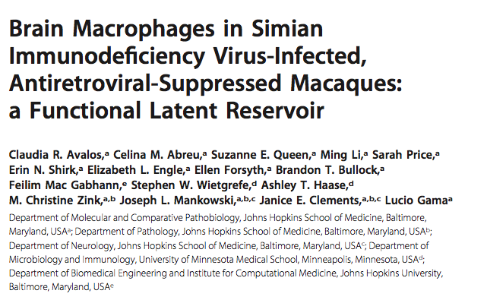
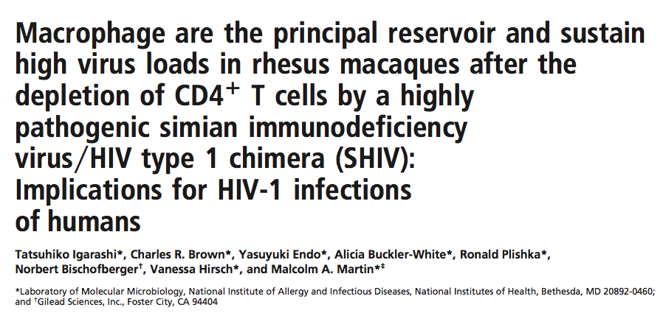
Background: In addition to CD4⁺ T cells, macrophages comprise the HIV reservoir in vivo
MBio. 2017 Aug 15;8(4).
Proc Natl Acad Sci U S A. 2001 Jan 16;98(2):658-63.
Today’s talk (Session Hide and Seek)

Slide 4
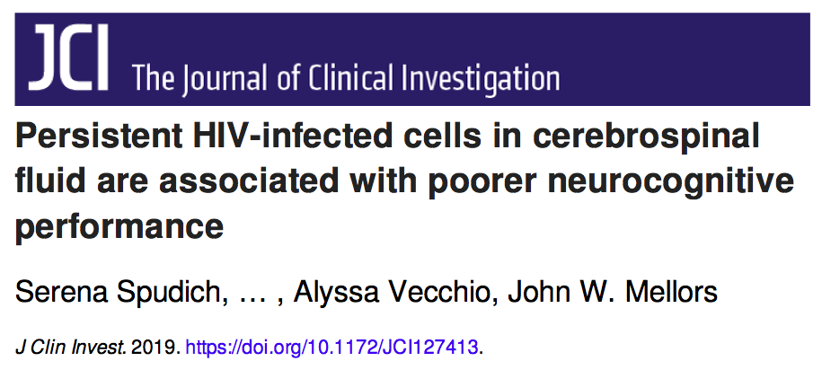
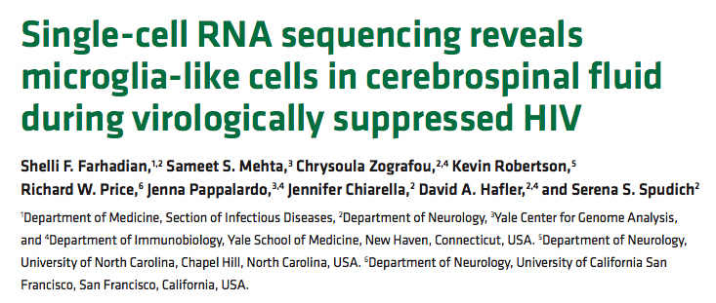
Why are we specifically targeting the myeloid reservoir?
Goal = Eliminate HIV in the CNS
JCI Insight. 2018 Sep 20;3(18).

Slide 5
We know that rapid HIV-1 replication results in cell death in CD4⁺ T cells
Activated CD4⁺ T Cells
Dividing cells
and
High abundant dNTPs
High dNTP pools =
Rapid HIV-1 replication
and cell death

Slide 6
In primary human macrophages, HIV-1 replication kinetics are different than CD4⁺ T cells
Human
macrophage
Low dNTP pools =
Slow HIV-1 replication
And little cell death
High dNTP pools =
Rapid virus replication
and cell death???

Slide 7
In primary human macrophages, HIV-1 replication kinetics are different than CD4⁺ T cells
Human
macrophage
Question:
Does accelerated viral replication in macrophages result in cell death?
Low dNTP pools =
Slow HIV-1 replication
and Little cell death
High dNTP pools =
Rapid virus replication
and cell death???
Ryoo, Kim and Ahn et al, Nat Med. 2014 Aug;20(8):936-41.

Slide 8
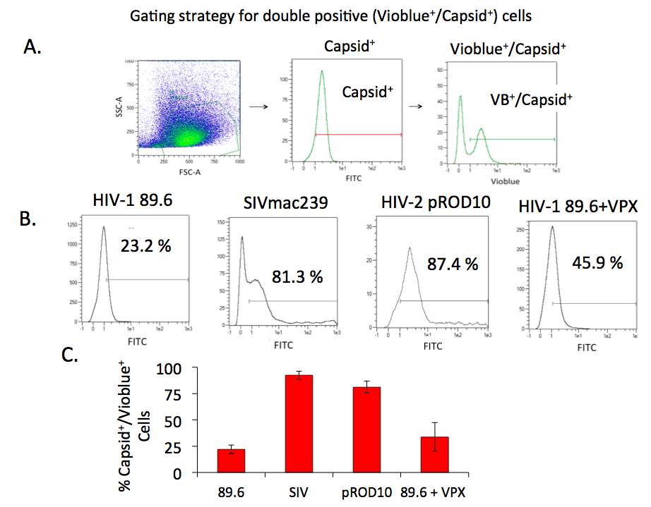
SIV and HIV-2, but not HIV-1, confer rapid cell death in infected macrophages

Slide 9
Goal
Identify repurposed FDA approved agents that can accelerate HIV-1 replication in primary human macrophages, resulting in cell death of ONLY infected macrophages.
Discover agents that can be used to specifically target HIV in the brain/CNS.

Slide 10
First Line Screen in 96 well plates seeded with primary human macrophages
Positive Control
Negative Control
Test Condition
eGFP Env
negative vector
+ Vpx
eGFP Env
negative vector
eGFP Env negative vector
+
candidate agent
that accelerates infection
Degrades SAMHD1
dNTP levels rise
NOT
GREEN
GREEN
GREEN

Slide 11
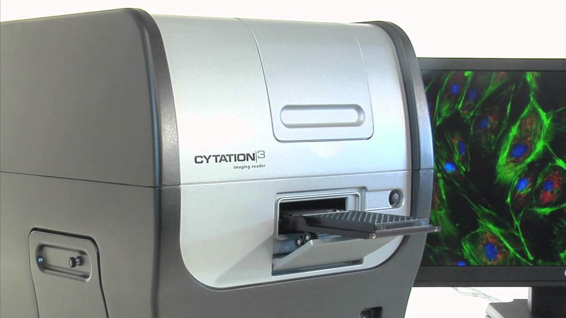
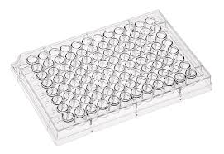
Project Logistics: High Throughput Screen of ~ 2,700 library (FDA approved, EU approved or Phase 3 agents)
Facilitated through Emory Center for Drug Discovery Pilot Award
Infect pooled primary human macrophages
(3 donors)
in 96 well plate with eGFP env- HIV-1 +/- 10 µM candidate agents
48 hr
fix plate
Example screen plate with test agents
+ Control (Vector + VPX)
- Control (Vector alone)

Slide 12
Discovery Funnel Towards High Specificity Agents
2,700 agents:
2,500 FDA approved/Phase 3 agents
200 natural products
57 agents accelerate HIV-1 replication in Mϕ
12 agents accelerate HIV-1 replication in Mϕ
AND kill the infected Mϕ
Two agents found to:
Accelerate HIV-1 replication in Mϕ
Kill the infected Mϕ
- Not kill uninfected Mϕ

Slide 13
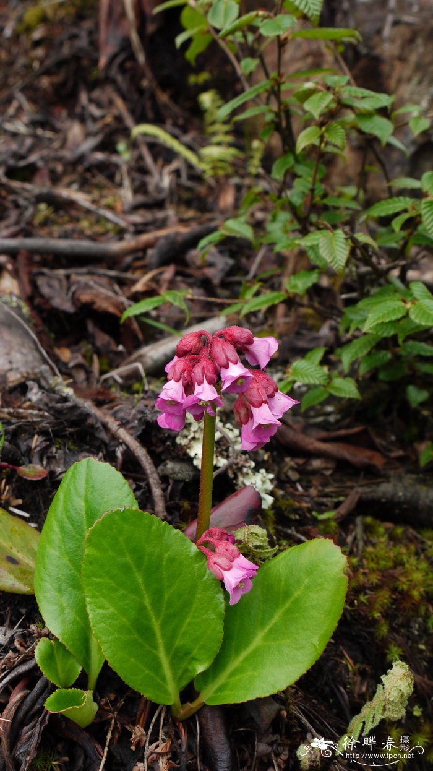
Candidate agents that selectively kill only HIV-infected macrophages
Bergenia
stracheyi plant
FDA approved indication = anti-seizure (2008, Novartis).
Oral bid dosing.
Approved for use in children (age 1-17).
BBB penetrant.
Mechanism of action = unknown; possibly impacting sodium channels.
Derived from natural sources.
Himalayan/Chinese origin.
Known immunomodulatory effects.

Slide 14
Additional Mechanistic & Drug Specificity Studies on Novel Agents
Dose response: Effect of rufinamide and bergenin on acceleration of HIV-1 replication in primary macrophages and microglia?
Effect of rufinamide and bergenin on SAMHD1 (key modulator of viral replication kinetics in myeloid cells)?
Specificity of rufinamide and bergenin towards only infected macrophages?

Slide 15
Rufinamide and Bergenin accelerate HIV-1 replication in primary human macrophages in env- vector system (green = acceleration)
Negative control
(HIV-1 vector alone)
Positive control
(HIV-1 vector + VPX)
HIV-1 vector +
10 µM Bergenin
HIV-1 vector +
10 µM Rufinamide
Green = HIV-1 acceleration.
Blue = DAPI nuclei stain to normalize data to cell number across wells.

Slide 16
Rufinamide and Bergenin selectively kill ONLY HIV-1 infected primary human macrophages and microglia using a live virus system (wild-type 89.6)
Rufinamide
Bergenin
% alive cells (Vioblue negative)
% alive cells (Vioblue negative)
0.01 0.1 1 10
0.01 0.1 1 10
µM Rufinamide
µM Bergenin
Microglia EC₅₀ = 0.07 µM
Microglia EC₅₀ = 0.03 µM
Macrophage EC₅₀ = < 0.01 µM
Macrophage EC₅₀ = 0.06 µM
= Uninfected Macrophages
= Uninfected Microglia
= Drug treated Microglia
X
= Drug treated Macrophages

Slide 17
Mechanism of HIV-1 replication acceleration is independent of SAMHD1/pSAMHD1

Slide 18
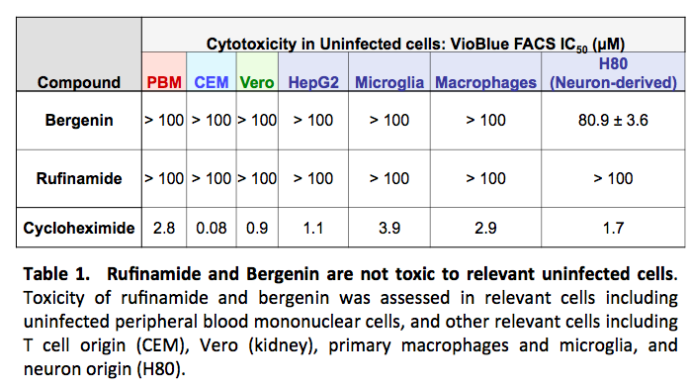
Rufinamide and bergenin are not toxic in different uninfected cells

Slide 19
Conclusions
There is a link between accelerated viral replication and cell death in primary human macrophages and microglia.
Rufinamide and bergenin accelerate HIV-1 replication in macrophages and microglia, resulting in cell death only of the infected cell.
Rufinamide and bergenin are not cytotoxic in uninfected cells including microglia and macrophages.
Rufinamide and bergenin do not increase SAMHD1 or pSAMHD1 levels.
Mechanism of HIV-1 replication acceleration is SAMHD1-independent.
Additional studies are warranted to define the exact mechanism of action
Plans are underway to evaluate these two repurposed drugs alone and in combination in animal models prior to studies in humans.

Slide 20
Acknowledgements
Emory University School of Medicine
Laboratory of Biochemical Pharmacology
Baek Kim, PhD
Raymond F. Schinazi, PhD, DSc
Caitlin Shepherd, MS
Jessica Holler, BS
Si’Ana Coggins, BS
Emory University Center for Drug Discovery
Emory Pilot award to fund this new initiative
NIH AIR01AI136581 (Baek Kim) and R01AI150451 (Baek Kim).
NIH MH11669502 (Raymond Schinazi)
P30AI050409 Emory University Center for AIDS Research

